Slide 1

Presentation for the BDM Capstone Project
Strategic Workforce Development
Analysis for Addressing Labour Shortage
Rashika Kukreja, 22f2001412

Slide 2
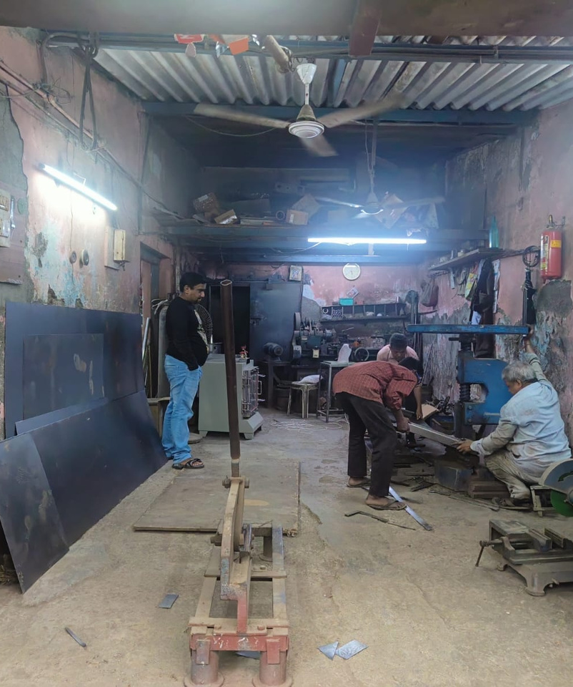
1
Introduction
Quality Instruments & Equipments
B2B manufacturing firm engaged in production of pharmaceutical and laboratory instruments.
Established in 1984 and is currently led by Mr. Gaurav Mestry.
Based in Kudal, Maharashtra, has a secondary manufacturing unit in Goregoan, Mumbai.
Key SKUs include ovens, dryers, heaters, incubators, cashew processing instruments.
Team of 13 employees.
Major clientele of the company includes pharma industries, laboratories and agro-processing industries in India as well as in Dubai and Africa.

Slide 3
2
Problems faced
Labour Shortage
High Cost of Skilled Labour
Employee Training VS Employee Recruitment
Workers leave for their native places in the months of June, July, August, September.
Shortage of labour hampers the production process.
Analysis of production process is necessary.
Products produced are highly knowledge intensive.
Such skilled labour is hired at a very high wage rate.
Analysis of the productivity of the workforce helps understand the requirement of excess labour.
Company seeks to understand the best approach between employee training and employee recruitment.
Both the approaches have their pros and cons.

Slide 4
3
Analysis Process
Data Collection
Data Analysis
Data was collected for the fiscal years 2021-2022 and 2022-2023.
Sales Data
Purchases Data
Payroll Data
Data visualizations such as bar plots, line charts, pie charts were made using ‘Plotly’ to identify the trends and patterns in the data.
Productivity analysis provided insights into labor output throughout the year, allowing for better manpower distribution.
A Linear Programming problem was formulated to optimize the production time in order to make the best possible use of the human resources.
A cost benefit analysis was conducted to identify the best strategy among employee training and employee recruitment.
The above analyses help find potential solutions.
Data Extraction and Cleaning
Sales and Purchase data was extracted from Tally Software.
Payroll data was saved in csv files.
Null values were excluded.
Irrelevant columns were discarded.

Slide 5
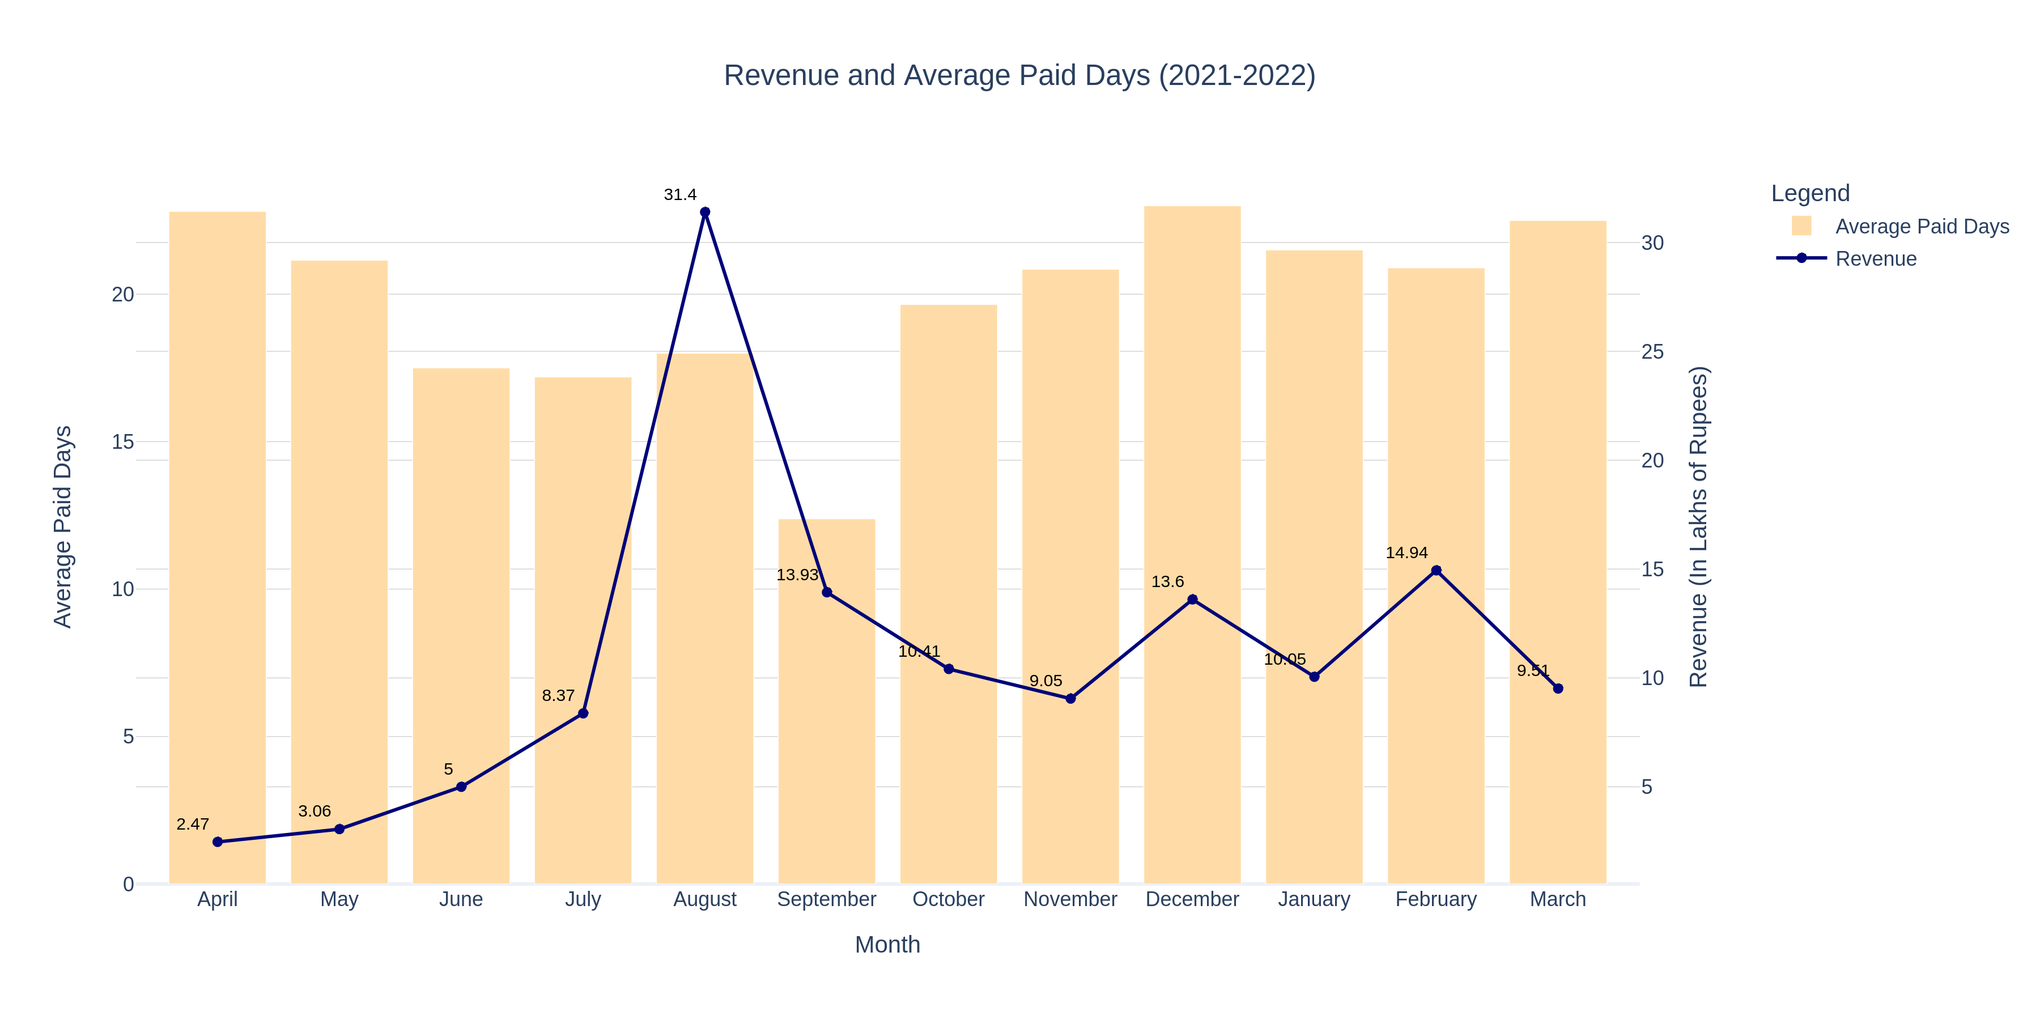
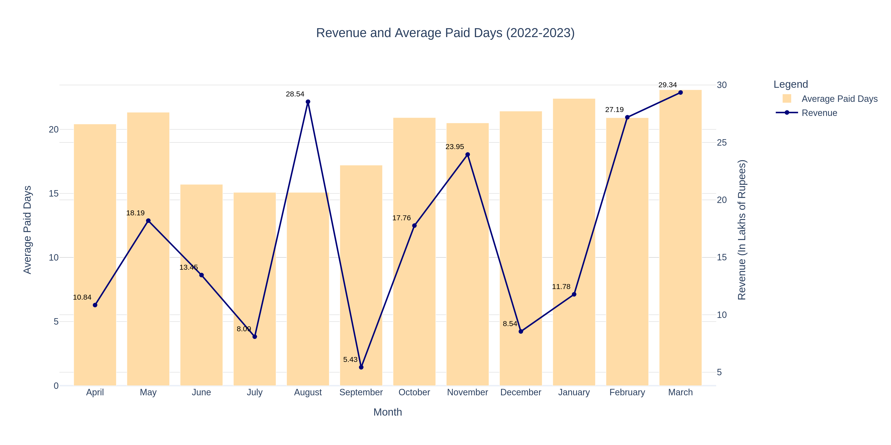
4
Trends in Revenue & Working Days
The Figures show the trend of revenue and average working days throughout the year.
It can be observed that during the months of high sales, the working days are lower.
August shows high revenue despite fewer paid days in both years.
Expected positive correlation between sales and working days is inconsistent for Quality Instruments and Equipments.
June, July, and September consistently have low paid days and low revenue.
In 2022-2023, revenue is generally higher than in 2021-2022, with some months showing a positive effect of increased working days on revenue.

Slide 6
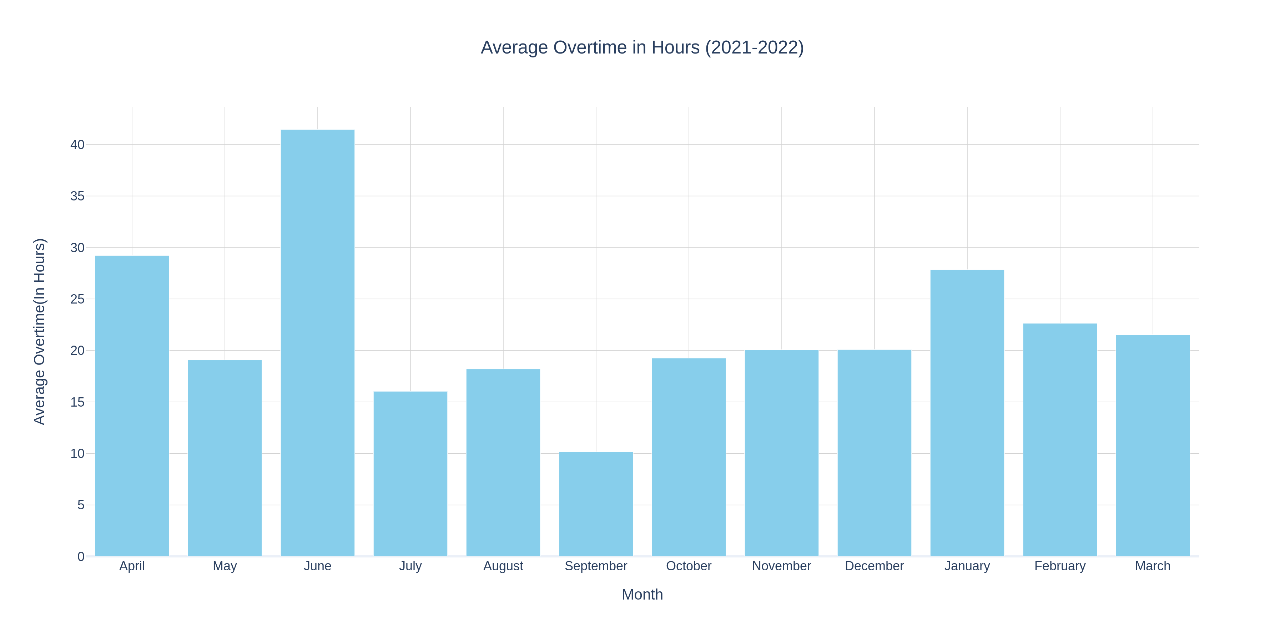
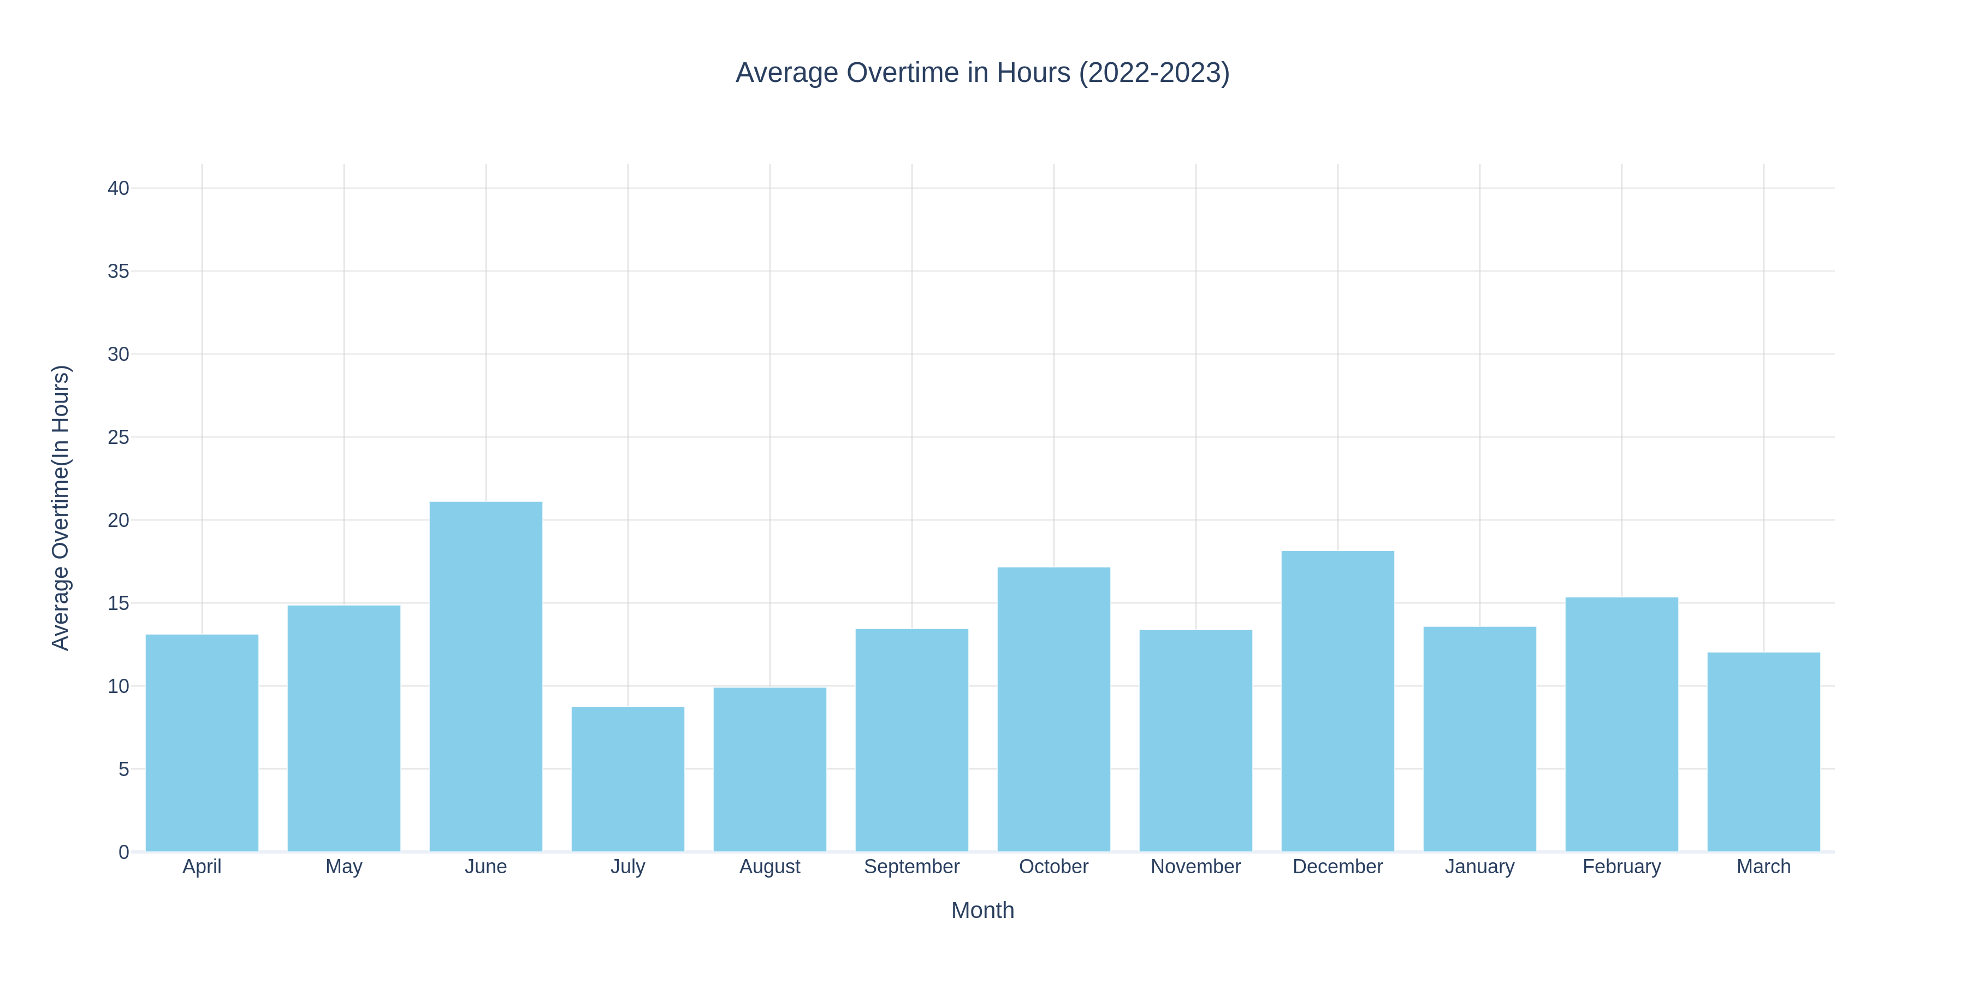
5
Overtime Trend
Employees work varying overtime hours, increasing salary expenses and additional costs (e.g., electricity).
Overtime hours are generally higher in 2021-2022 than in 2022-2023.
June 2021 had the highest overtime (>40 hours), indicating an extra 5 working days per employee, despite low revenue and demand.
High overtime in January 2022, June 2022, and December 2022 also indicates inefficient use of working shifts.

Slide 7
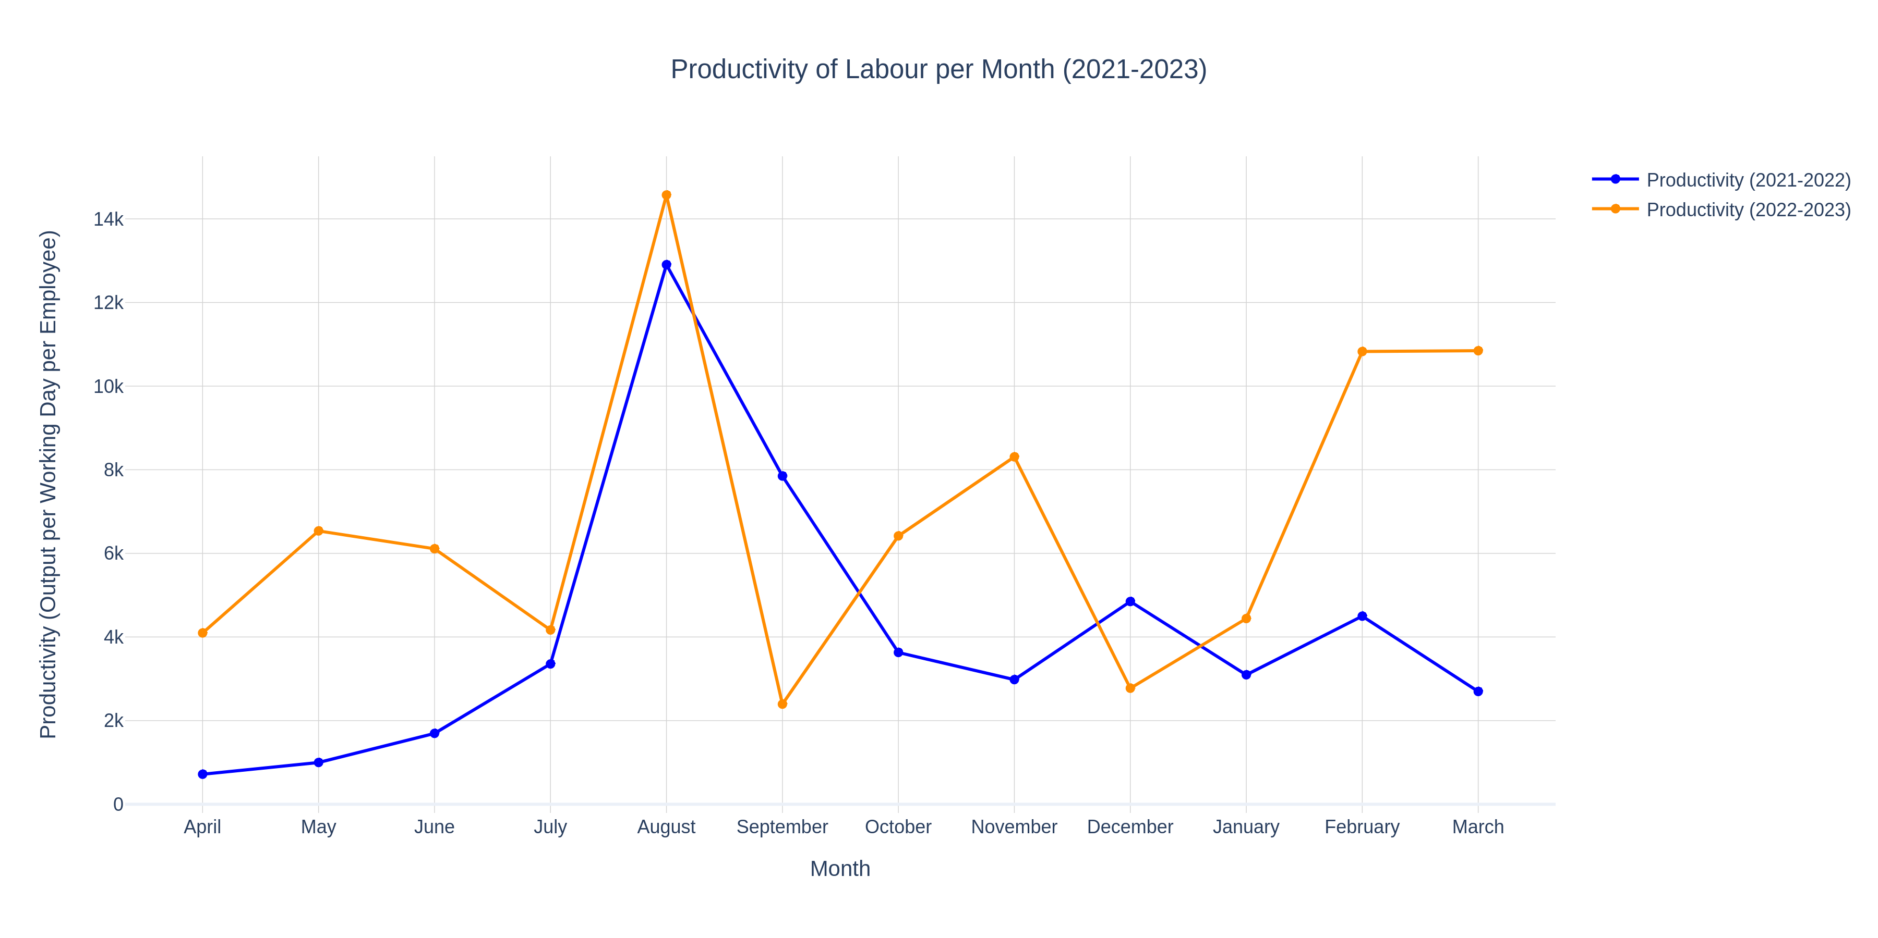
6
Productivity Analysis
Observation
The graph plots the productivity calculated as per the metric.
It can be observed that the productivity remains low for most months of the year in 2021-2022.
August shows high productivity in both years due to high sales.
Labour availability is low in August, yet output remains high, suggesting high efficiency.
Other months have more labor but lower productivity, indicating potential inefficiencies in productivity
Metric Interpretation
The metric used for productivity is output per paid day per employee.
The interpretation of the metric is the contribution to sales per day of each employee.
For example, in the month of April 2022, the productivity is ₹ 4000, this means, each employee contributed ₹ 4000 to the sales each day.

Slide 8
7
Linear Programming Problem
Methodology
In order to optimize the working days as per the production, a linear programming problem was formulated as follows:
The objective was to minimize the total production days needed for each product.
1st constraint- The current level of profitability should be maintained
2nd constraint – The optimized production time cannot be more than the available production time in a month.
3rd constraint – Number of each product produced should be at least as much as demanded.
These LPPs were formulated and solved for each month for the years 2021-2022 and 2022-2023.
Month | Status | Actual Paid Days | Optimized Paid Days
April | Optimal | 324 | 96
May | Optimal | 300 | 104
June | Optimal | 288 | 110
July | Optimal | 252 | 118
August | Infeasible | 252 | 162.1863
September | Infeasible | 180 | 183.2206
October | Optimal | 276 | 156
November | Optimal | 288 | 58
December | Optimal | 312 | 182
January | Infeasible | 312 | 300.6808
February | Optimal | 288 | 156
March | Optimal | 312 | 206
Month | Status | Actual Paid Days | Optimized Paid Days
April | Optimal | 276 | 121
May | Optimal | 288 | 88
June | Infeasible | 228 | 195.075
July | Infeasible | 216 | 206
August | Infeasible | 216 | 164.6182
September | Optimal | 240 | 108
October | Infeasible | 288 | 213.7886
November | Optimal | 276 | 169
December | Optimal | 300 | 160
January | Optimal | 300 | 74
February | Infeasible | 276 | 220.6264
March | Infeasible | 312 | 359.5616
Results of LPP for the year 2021-2022
Results of LPP for the year 2022-2023
Notes:
The Distribution of Working Days, Overtime Trend and the results of Productivity analysis suggest inefficiencies in the allocation of manpower.

Slide 9
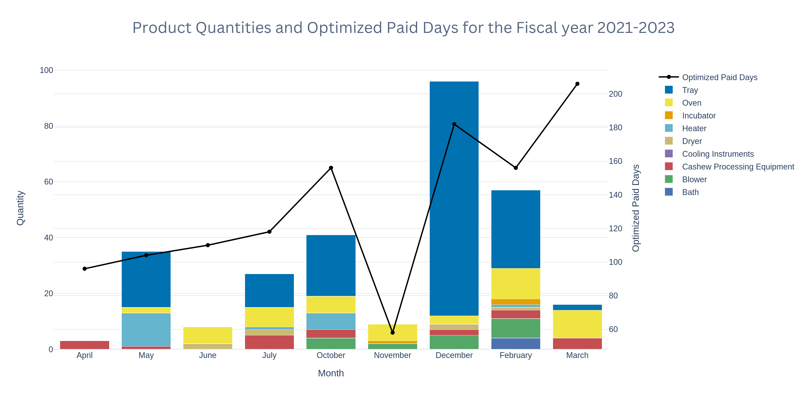
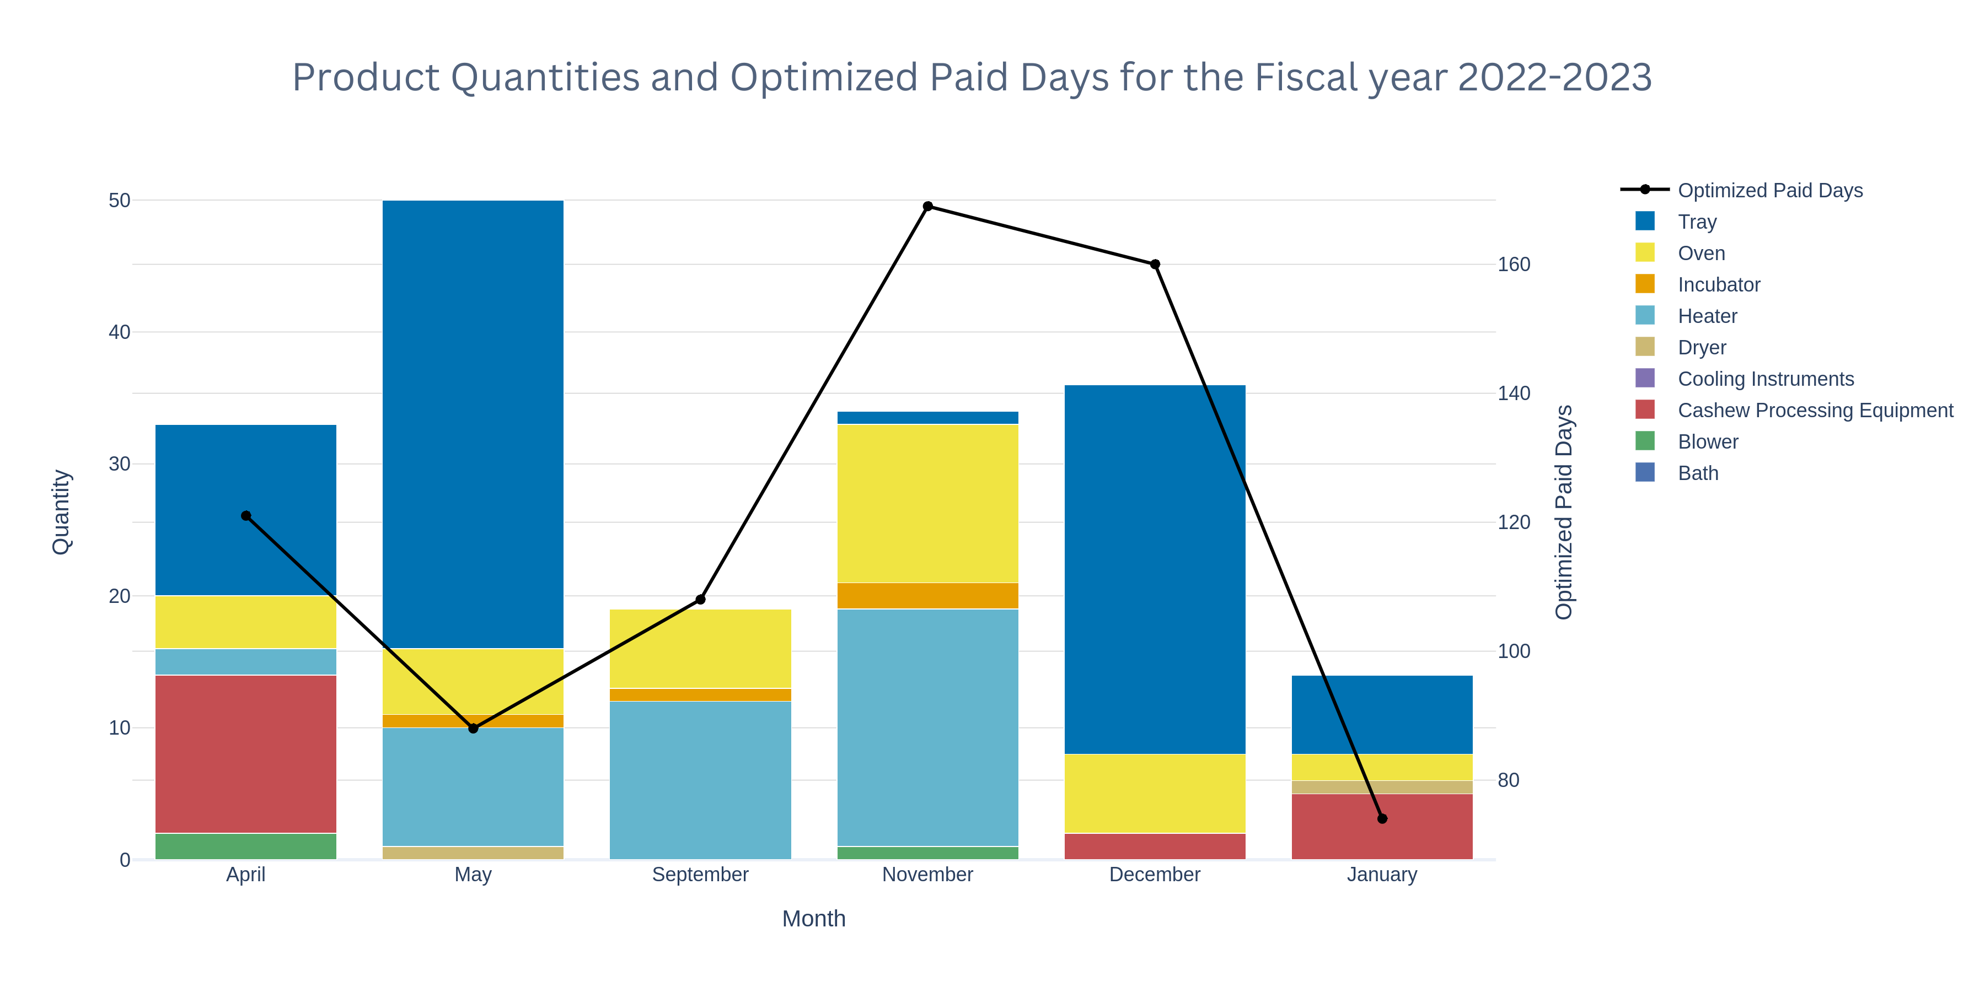
8
Optimized Allocation of Working Days
For the months where the Status is optimal, the production can be completed within the optimized production days rather than the actual production days.
The results indicate that the allocated days for production are far more than what is required.
The optimized paid days are plotted against the quantities of products to be produced for the feasible months.
The LPP model adjusts itself according to the type and quantity of product to be produced.
Hence, the demand in most months of the year can be met by each employee working for lesser than 25 days.

Slide 10
9
Employee Training V/S Employee Recruitment
Employee Training Benefits: Training helps close skill gaps, improves morale, and boosts productivity, allowing employees to work more efficiently and explore new industries.
Risks of Training: Trained employees may leave for better-paying jobs, leading to lost training costs and potential additional retention expenses.
Hiring Skilled Employees: Bypasses training costs but requires higher wages and incurs recruitment expenses.
Balanced Strategy: Combining training with selective hiring is more effective, especially during periods of reduced labor demand.
Utilizing Low-Demand Periods: Employees can be trained during low-demand months, enhancing skills without disrupting production.
Long-Term Workforce Development: A balanced approach with ongoing training and strategic hiring addresses labor shortages and enhances productivity over time.

Slide 11
10
Recommendations
Optimizing resource use by focusing on skill enhancement during low-demand periods and pre-producing common components used in products can address labor shortages and improve efficiency. Outsourcing non-core equipment production allows the company to focus on essential manufacturing activities.
1
Increasing productivity during regular hours reduces the need for overtime, preventing employee burnout and minimizing additional operational costs, while maintaining employee well-being.
2
Short-term wage hikes increase costs without solving the root cause of labor shortages. A long-term solution focused on skill enhancement is needed to bridge the technology-skills gap, boost worker morale, and foster job satisfaction, leading to greater employee engagement.
3
To address labor shortages during monsoon months, the company can incentivize attendance by offering higher wages, bonuses, or a commission based on sales. This strategy encourages workers to remain at their jobs during low attendance periods.
4
5
Regular process monitoring and adopting new technologies are crucial for resource optimization and staying competitive in the manufacturing industry.

Slide 12
Thank you

